Slide 1
PHP Operators?
"Operators are used to perform operations on variables and values.”
Operators are used to performing operations on some values. In other words, we can describe operators as something that takes some values, performs some operation on them, and gives a result.
From example, “1 + 2 = 3” in this expression ‘+’ is an operator. It takes two values 1 and 2, performs an addition operation on them to give 3.

Slide 2
PHP Operators
PHP also supports various types of operations like arithmetic operations(addition, subtraction, etc), logical operations(AND, OR etc), Increment/Decrement Operations, etc.
These operators are nothing but symbols needed to perform operations of various types.

Slide 3
PHP Operators Groups:
Arithmetic operators
Assignment operators
Comparison operators
Increment/Decrement operators
Logical operators
String operators
Array operators

Slide 4
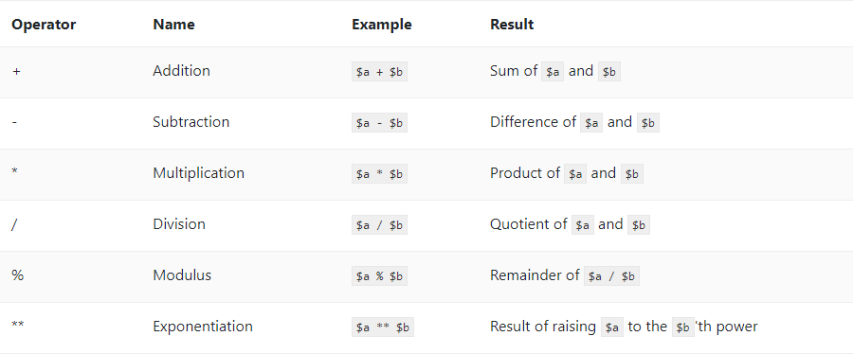
PHP Arithmetic Operators
The PHP arithmetic operators are used with numeric values to perform common arithmetical operations, such as addition, subtraction, multiplication etc.

Slide 5
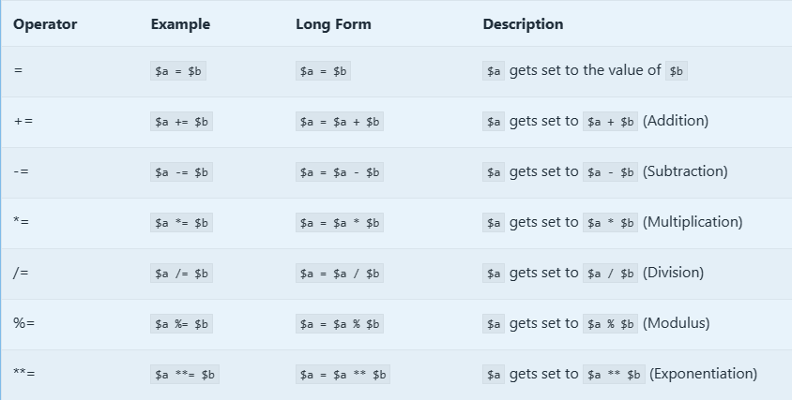
PHP Assignments Operators
The PHP assignment operators are used with numeric values to write a value to a variable.

Slide 6
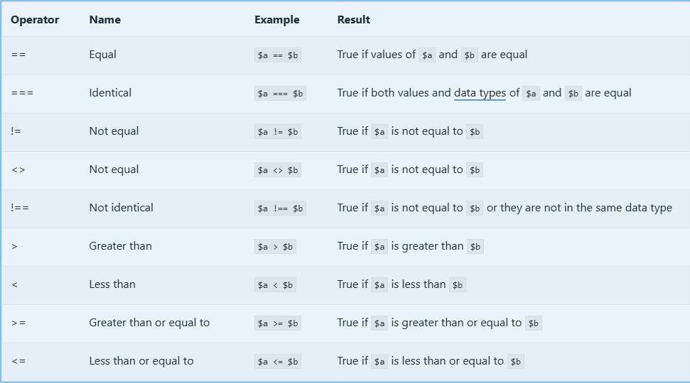
PHP Comparison Operators
Comparison Operators allow you to compare two values.

Slide 7
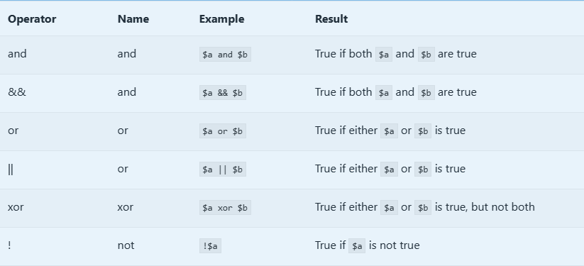
PHP Logical Operators
A logical operator is a kind used in logic. In PHP, all logical operators return a boolean value.

Slide 8
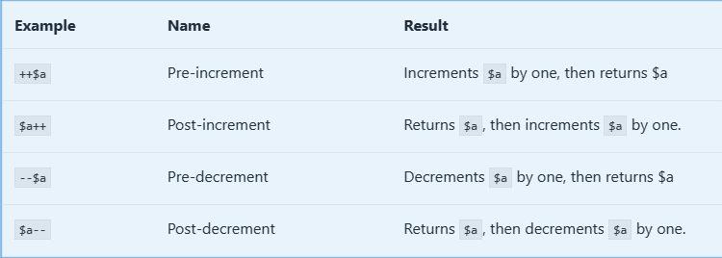
Incrementing/Decrementing Operators
PHP's incrementing and decrementing operators are used to increment and decrement values respectively.

Slide 9
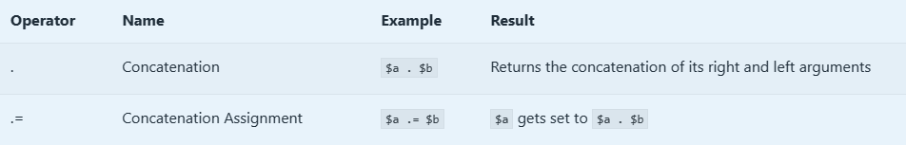
String Operators
There are two special string operators what help us to operate strings.

Slide 10
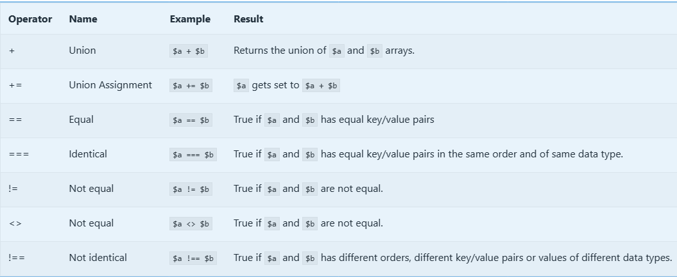
Array Operators
PHP array operators are used to perform operations on arrays.

Slide 11
Vielen Dank.

